Slide 1

📄 InvoiceInsight PRO AI Advanced Multilingual Document Intelligence & Financial Analytics Platform

Slide 2
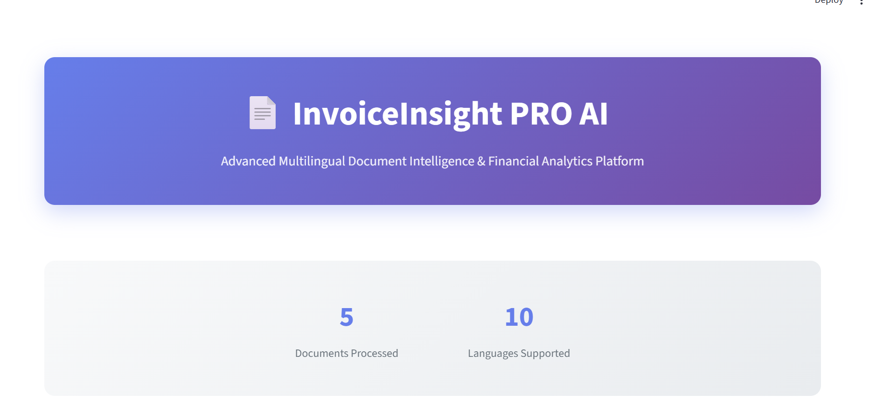
InvoiceInsight PRO AI Main Page
Introduces InvoiceInsight PRO AI and its advanced document analytics platform.
Shows the number of processed documents and supported languages.
Emphasizes multilingual, financial analytics capability for businesses

Slide 3
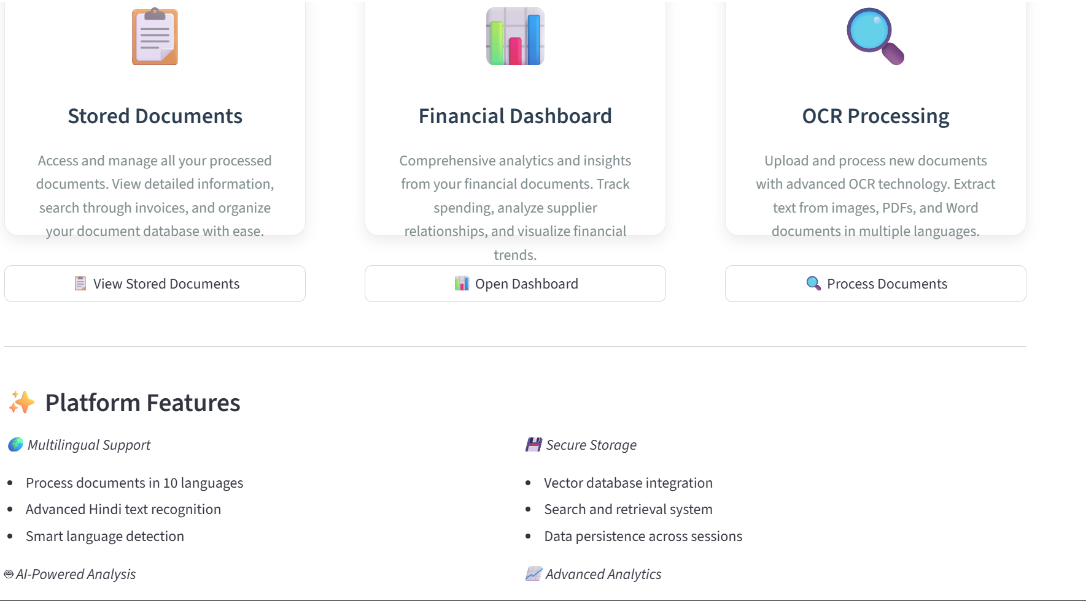
Platform Navigation Page
Highlights quick access to stored documents, analytics dashboard, and OCR processing.
Describes primary platform modules for document management and analysis.
Facilitates document uploading, searching, and insights from one interface.

Slide 4
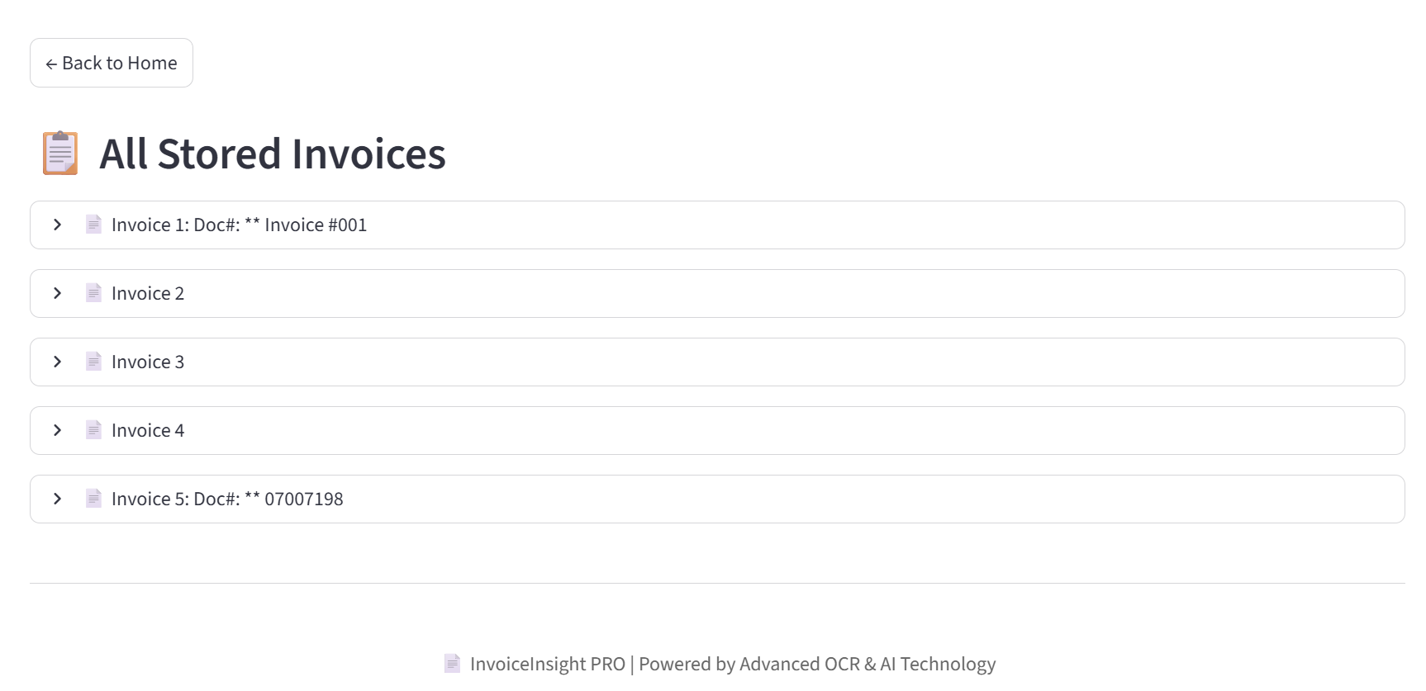
Stored Invoices Page
Displays a list of all processed and stored invoices in the VectorDB.
Provides easy navigation to view details for every invoice.
Ensures transparency and tracking of document history.

Slide 5
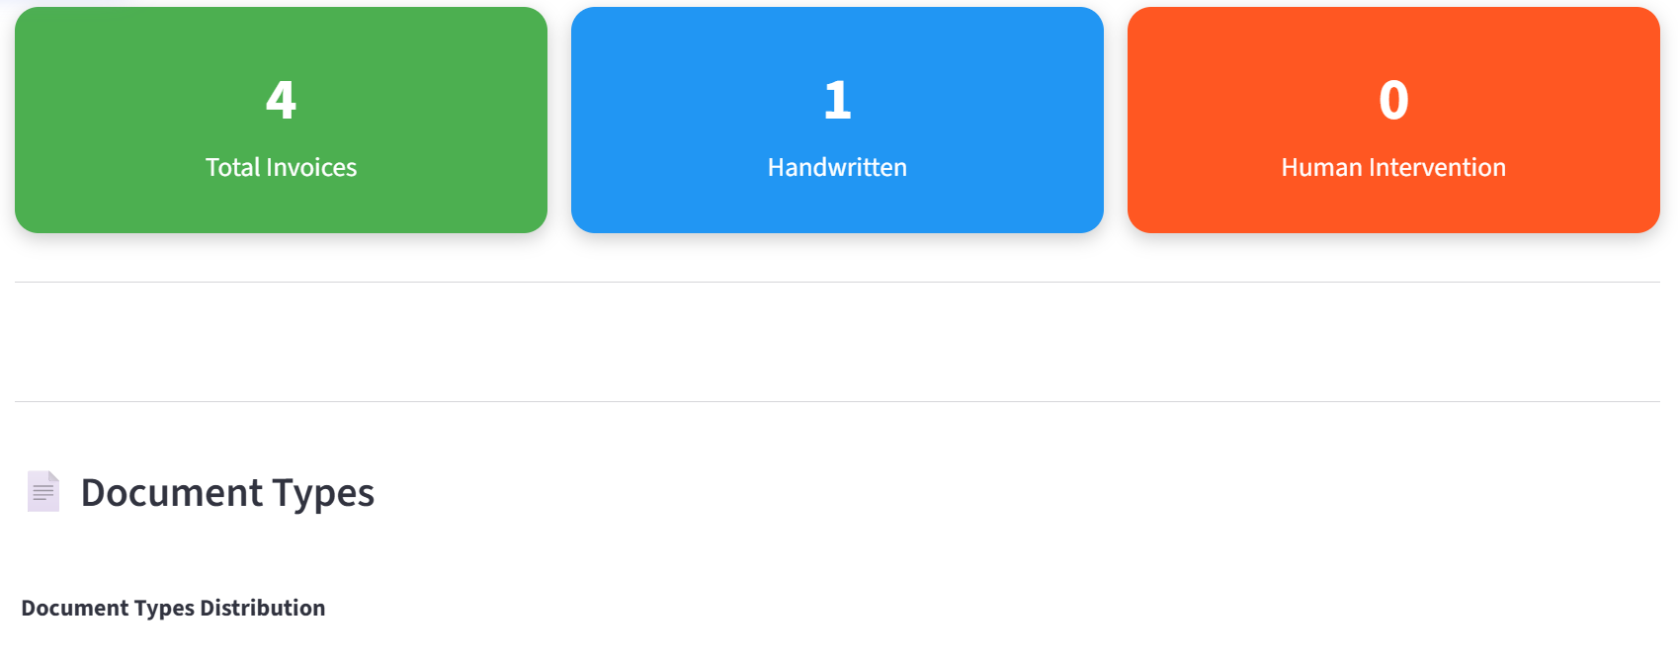
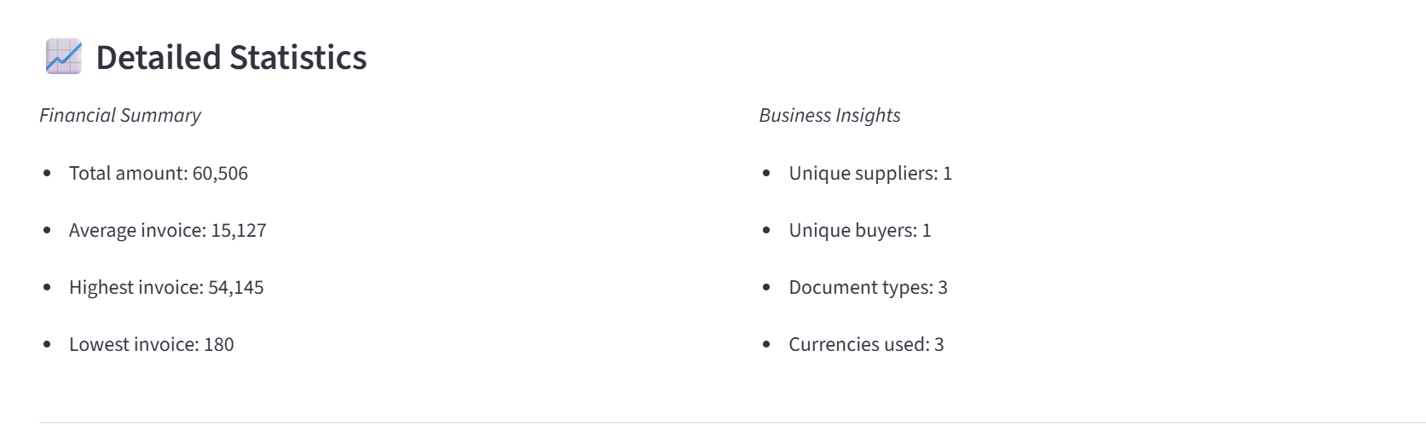
FINANCIAL DASHBOARD PAGE
Provides financial summary including total, average, highest, and lowest invoice amounts.
Highlights unique business relationships with count of suppliers and buyers.
Displays variety in processed documents (types and currencies used).
Provides financial summary including total, average, highest, and lowest invoice amounts.
Highlights unique business relationships with count of suppliers and buyers.
Displays variety in processed documents (types and currencies used)

Slide 6
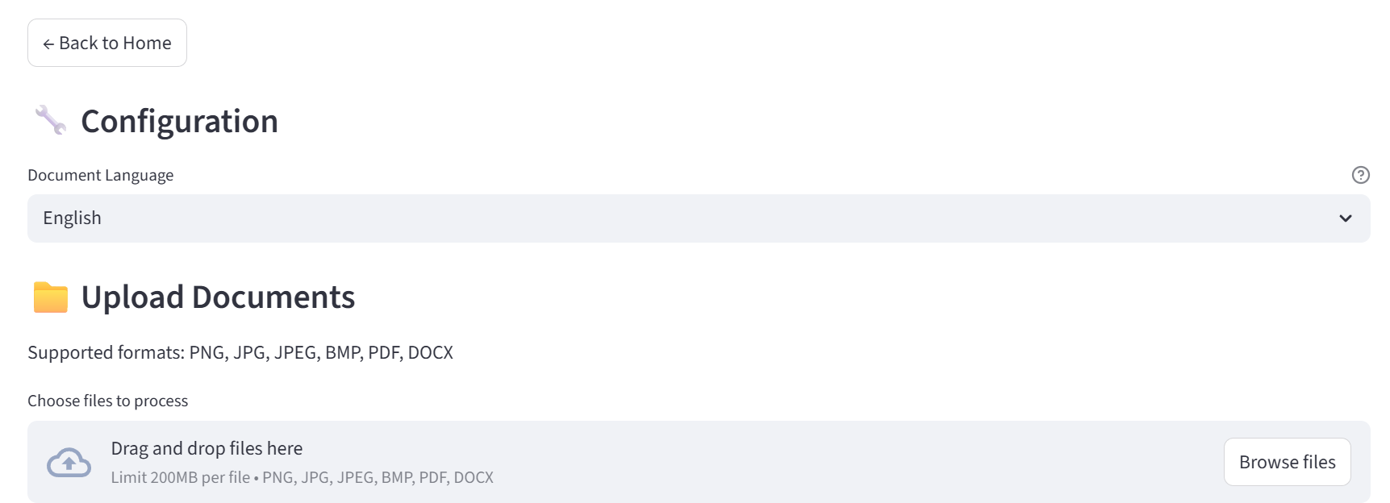
Document Configuration & Upload
.
Allows users to set the preferred document language for processing, shown here as English.
Provides a simple drag-and-drop interface to upload files for analysis.
Supports popular file formats including PNG, JPG, JPEG, BMP, PDF, and DOCX, with a size limit per file.
Designed to streamline document processing and enhance user convenience.

